Slide 1

T5 Bootcamp
MTA Descriptive Data Analysis
Presented by: Faisal , Samer

Slide 2
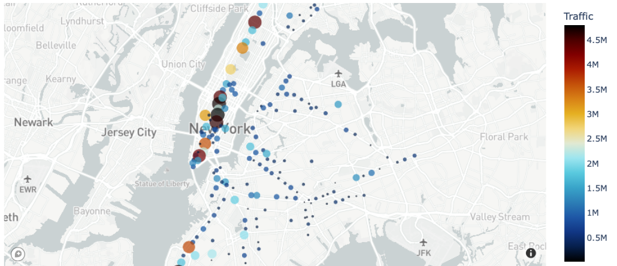
Business needs
Our goal is to find the crowded stations and empty stations, In order to improve customer experience, Getting in and out of station easily, Find the best time to scheduled maintenance day and cleaning time.

Slide 3
Approach and Methodology
1- We took the data from MTA website.
2- We did a data cleaning , removing the extra space of the heading column and removing duplicate, null values and outliers.
3- We added column called Traffic, actual entry and exit.
4- We use these libraries:
Numpy
Pandas
Matplotlib
Plotly

Slide 4
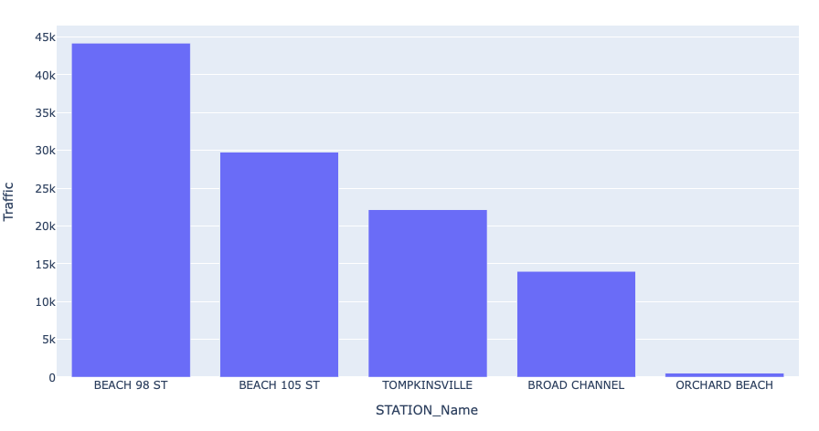
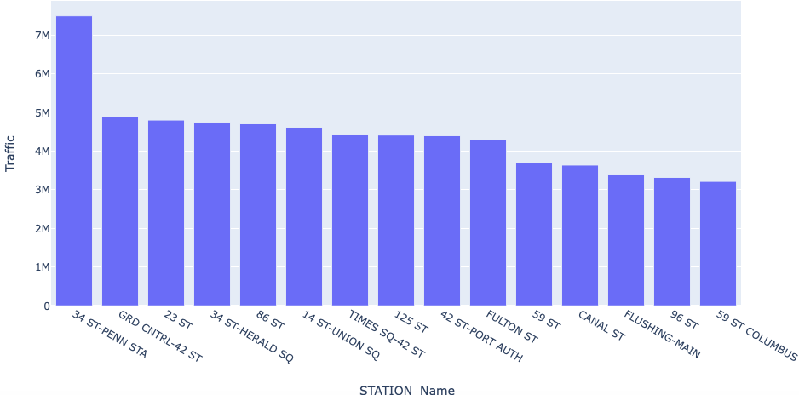
Analysis
We found highest and lowest traffic stations, hourly traffic.

Slide 5
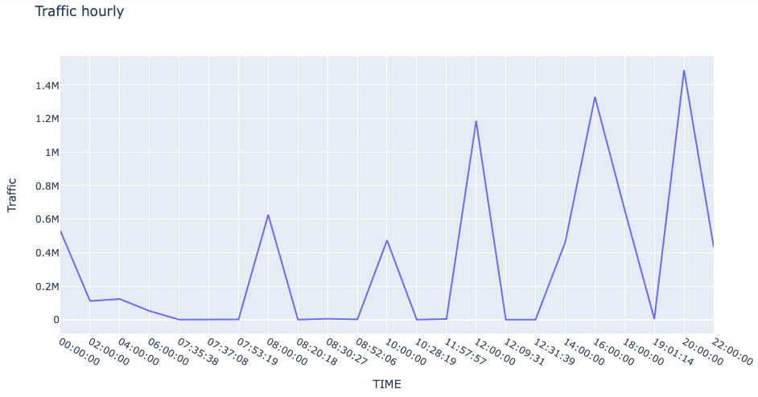
Result
Crowded Station
Empty station
Busy hours
Getting in and out of station
Maintenance day
Cleaning time
Best advertising locations

Slide 6
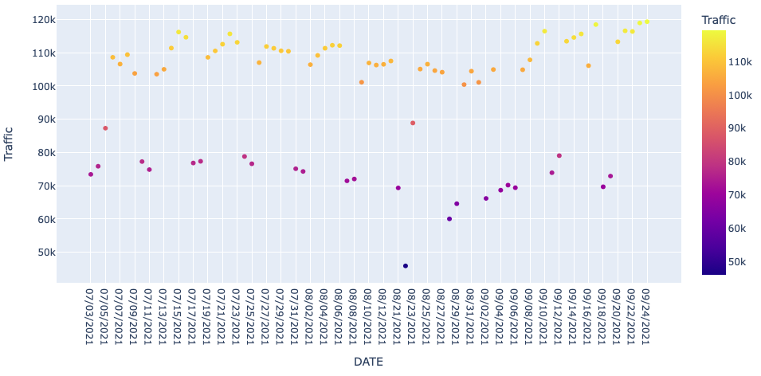
Result

Slide 7
Recommendation
Check on least crowded stations
Open a new station on most crowded location
Introduce new train on most crowded stations
Introduce new turnstile app and technology
Collect feedbacks from customers

Slide 8
Thank you
-any question ?

